Slide 1


Project Presentation
BY:
PRASHANT(22MCA20999)
ISHA SAINI(22MCA20902)

Slide 2



Upgrade
Prashant
Welcome
What is Spotify?
Introduction
Introduction
WHAT IS SPOTIFY?
Agenda
Our Services
Achievements
SPOTIFY IS A PODCAST, MUSIC STREAMING FREEMIUM SERIVCE
Our Goals
Gallery
Pricing
Overview:
User Empowerment
Contact Us
Spotify offers over 300 million songs from various genres with a user-friendly interface.
Users can listen to their favourite artist, album, and discover new music in an easy manner.
Spotify provides two versions of it’s application: FREE & PREMIUM.
Wide variety of music
Variety of playlists to fit the user’s environment or mood

Slide 3
Upgrade
PRASHANT
Introduction
Play
Follow
About Us
Our Teams
Introduction
Agenda
Our Services
Overview of the Spotify Clone project:
  A web application designed to emulate the user experience of Spotify.
  Developed to provide a familiar yet innovative platform for music enthusiasts.
Motivation:
  Addressed the demand for personalized and immersive offline music streaming experiences.
Development Focus:
  Demonstrated web development and design skills through the creation of a Spotify-inspired platform.
Aim:
  Redefining online music listening with a focus on user-centric features and cutting-edge technologies.
Achievements
Our Goals
Gallery
Pricing
Contact Us

Slide 4

Upgrade
PRASHANT
Welcome
About Us
PROJECT DETAILS
Project Details
Agenda
Our Services
Development Stack:
HTML, CSS, and JavaScript for the front end.
(Specify any back-end technologies used, if applicable).
Achievements
Our Goals
Gallery
Key Features:
Offline song support for uninterrupted listening.
User authentication with a login page and signup functionality.
Library with curated playlists of selected songs.
Pricing
Contact Us

Slide 5
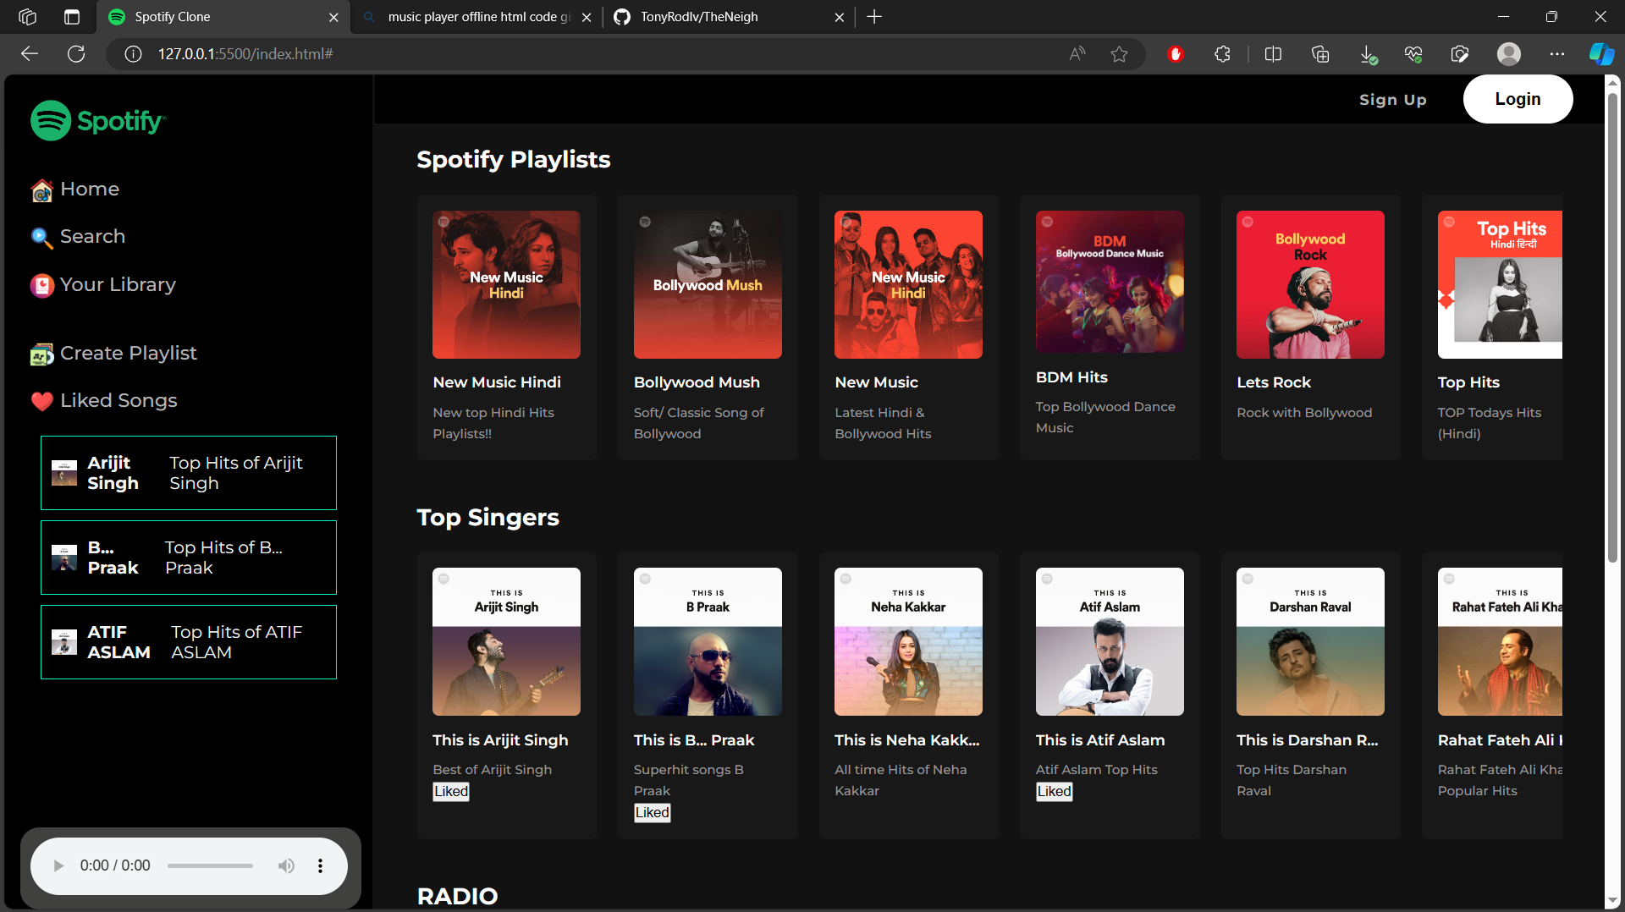

Upgrade
PRASHANT
Welcome
About Us
Daily Agenda
Our Teams
Agenda
Agenda
Our Services
Achievements
#
Title
Tasks
Events
Our Goals
1
Nihil impedit quo minus id quod
Maxime placeat
Dolorum fuga
08:00
Gallery
2
Nobis est eligendi optio cumque
Quo minus
Mollitia animi
10:00
Pricing
3
Minus id quod maxime
Eveniet ut
Aut officiis
12:00
Contact Us
4
Cum soluta nobis est eligendi
Saepe eveniet
Voluptates
14:00
5
Voluptates repudiandae sint molestiae
Officiis debitis
Quibusdam
17:00

Slide 6
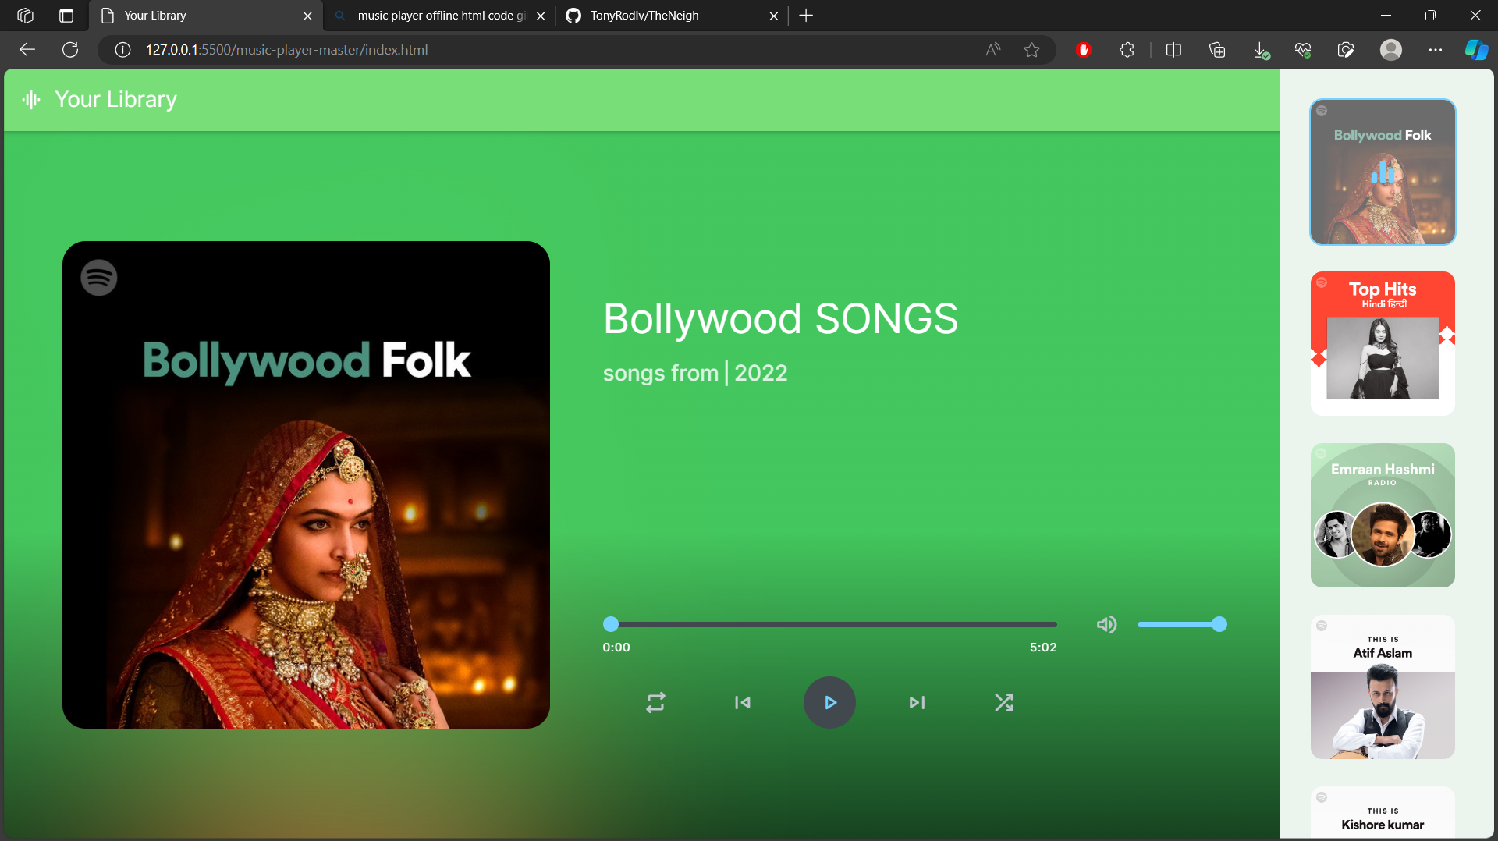
Upgrade
PRASHANT
Welcome
About Us
Our Teams
Achievements
Agenda
Our Services
Awesome Projects
Achievements
Our Goals
20k
50+
15+
35k
Gallery
Pricing
Contact Us
Quo minus
Eveniet ut
Voluptates
Maximas
Achieved
Achieved
Achieved
Achieved

Slide 7
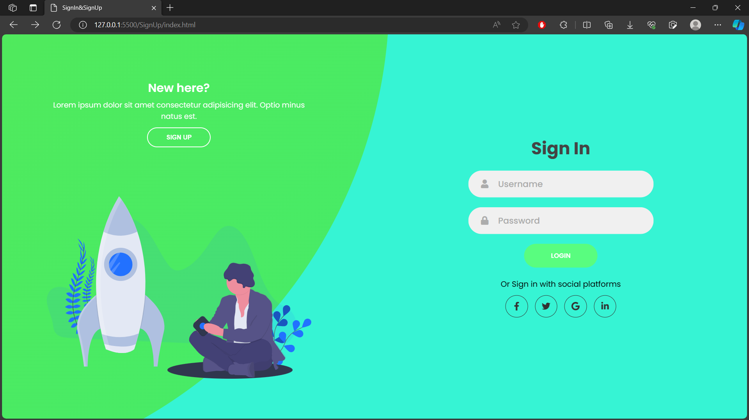
Upgrade
PRASHANT
Welcome
About Us
Our Teams
Our Services
Agenda
Our Services
Duis aute irure dolor in reprehenderit in voluptate velit esse cillum dolore eu fugiat nulla pariatur. Excepteur sint occaecat cupidatat non proident, sunt in culpa qui officia deserunt mollit anim id est laborum.
Achievements
01
Itaque earum
04
Rerum facilis est
Our Goals
Gallery
02
Officiis debitis
05
Sint occaecati
Pricing
Contact Us
03
Nam libero
06
Wui blanditiis

Slide 8




Upgrade
PRASHANT
Welcome
Our Goals
About Us
Our Teams
User Profiling:
  Explanation of algorithms used to understand user preferences.
Personalized Playlist Curation:
  Details on how the system curates playlists based on user preferences.
Music Discovery through Machine Learning:
  Overview of algorithms for recommending new music based on user history.
Agenda
Our Services
Goal 01
Goal 02
Achievements
Our Goals
Challenges
FUTURES Goals
Goal 03
Goal 04
Pricing
Expansion into New Markets:
Identify potential markets for growth and expansion.
Integration with Emerging Technologies:
Explore possibilities of incorporating emerging technologies (e.g., AI, AR/VR).
Innovative User Acquisition Strategies:
Strategies to attract and retain a diverse user base.
Contact Us

Slide 9
Upgrade
PRASHANT
Welcome
About Us
Our Teams
Challenges
Agenda
Our Services
Scalability:
Strategies employed to ensure the platform can handle increased user load.
Strategies to Overcome Challenges:
Specific solutions and approaches implement
Achievements
Our Goals
CHALLENGES
Data Security:
Measures taken to protect user data and ensure privacy.
CONCLUSION
Copyright Considerations:
How legal and copyright issues were addressed during development.
Contact Us

Slide 10


Upgrade
PRASHANT
Welcome
About Us
Our Teams
Conclusion
Agenda
Our Services
Testament to the Evolving Landscape:
  Reinforce how the Spotify Clone adapts to changes in the music streaming industry.
Captivating a Diverse Audience:
  Discuss how the platform aims to engage users with different preferences.
Promising Future:
  Highlight the potential impact and success of the Spotify Clone in the digital music streaming ecosystem.
Achievements
Our Goals
Gallery
CONCLUSION
Contact Us

Slide 11


Thank You
Any Questions?
Despacito
Luis Fonsi, Daddy Yankee
0:23
-3:25

